Slide 1
Web Apps with REST-ful API
Dr. Leon Jololian

Slide 2
IBM Bluemix
IBM Bluemix is a cloud platform as a service (PaaS) developed by IBM.
It supports several programming languages and services as well as integrated DevOps to build, run, deploy and manage applications on the cloud.
Bluemix supports several programming languages including Java, Node.js, Go, PHP, Swift, Python, Ruby Sinatra, Ruby on Rails and can be extended to support other languages.

Slide 3
The Cloudant NoSQL Database
Cloudant is a NoSQL document database (not a relational database).
A NoSQL database contains a collection of JSON-formatted documents.
The database is maintained on the cloud and is widely accessible.
Cloudant’s RESTful API makes every document in your database accessible as JSON.

Slide 4
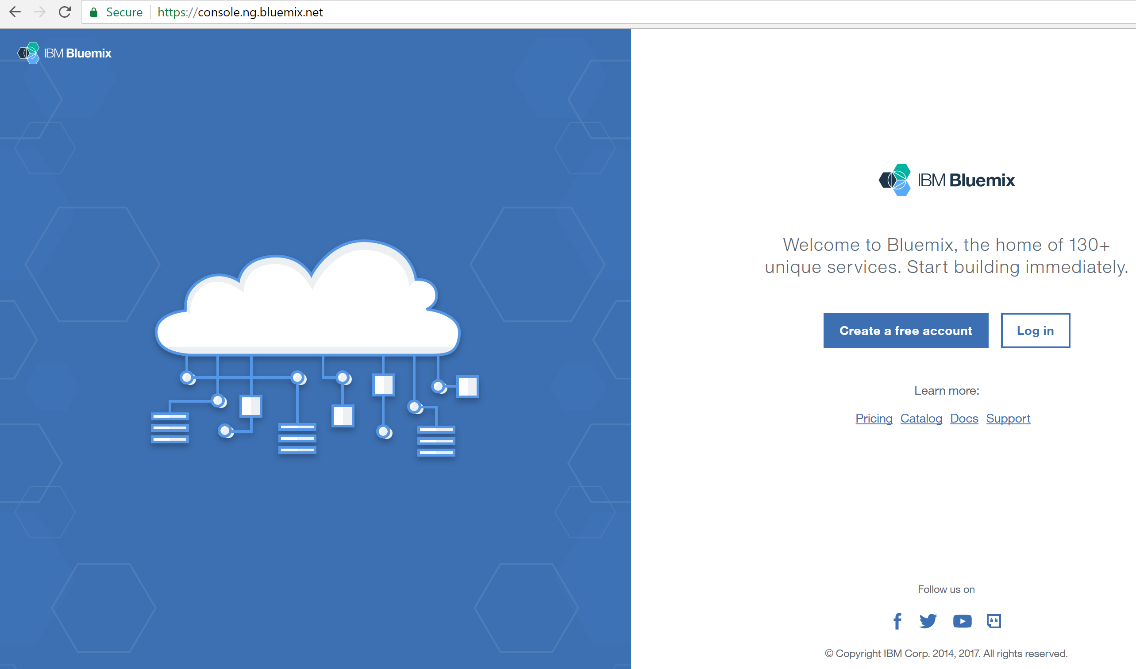
Getting Started with Bluemix
Go to:
http://bluemix.net/
Create:
a free account
Log in

Slide 5
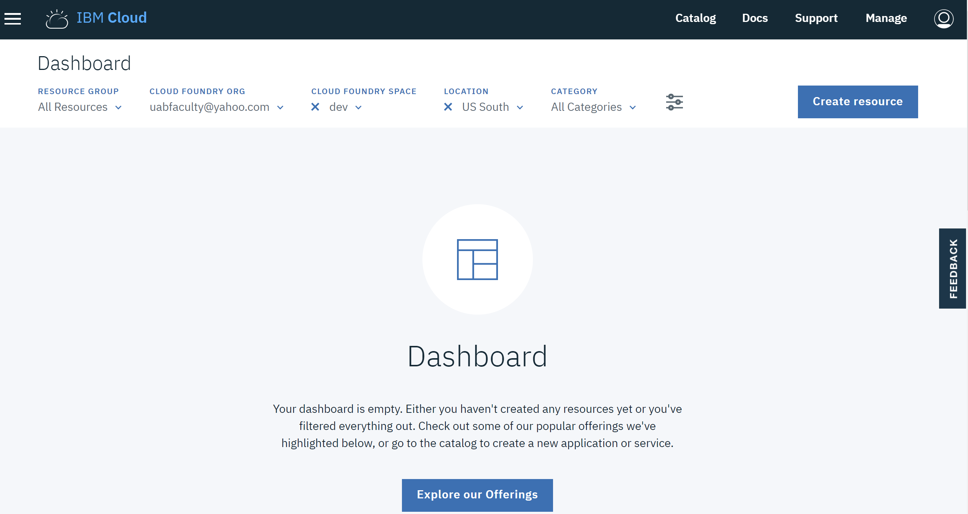
The Dashboard

Slide 6
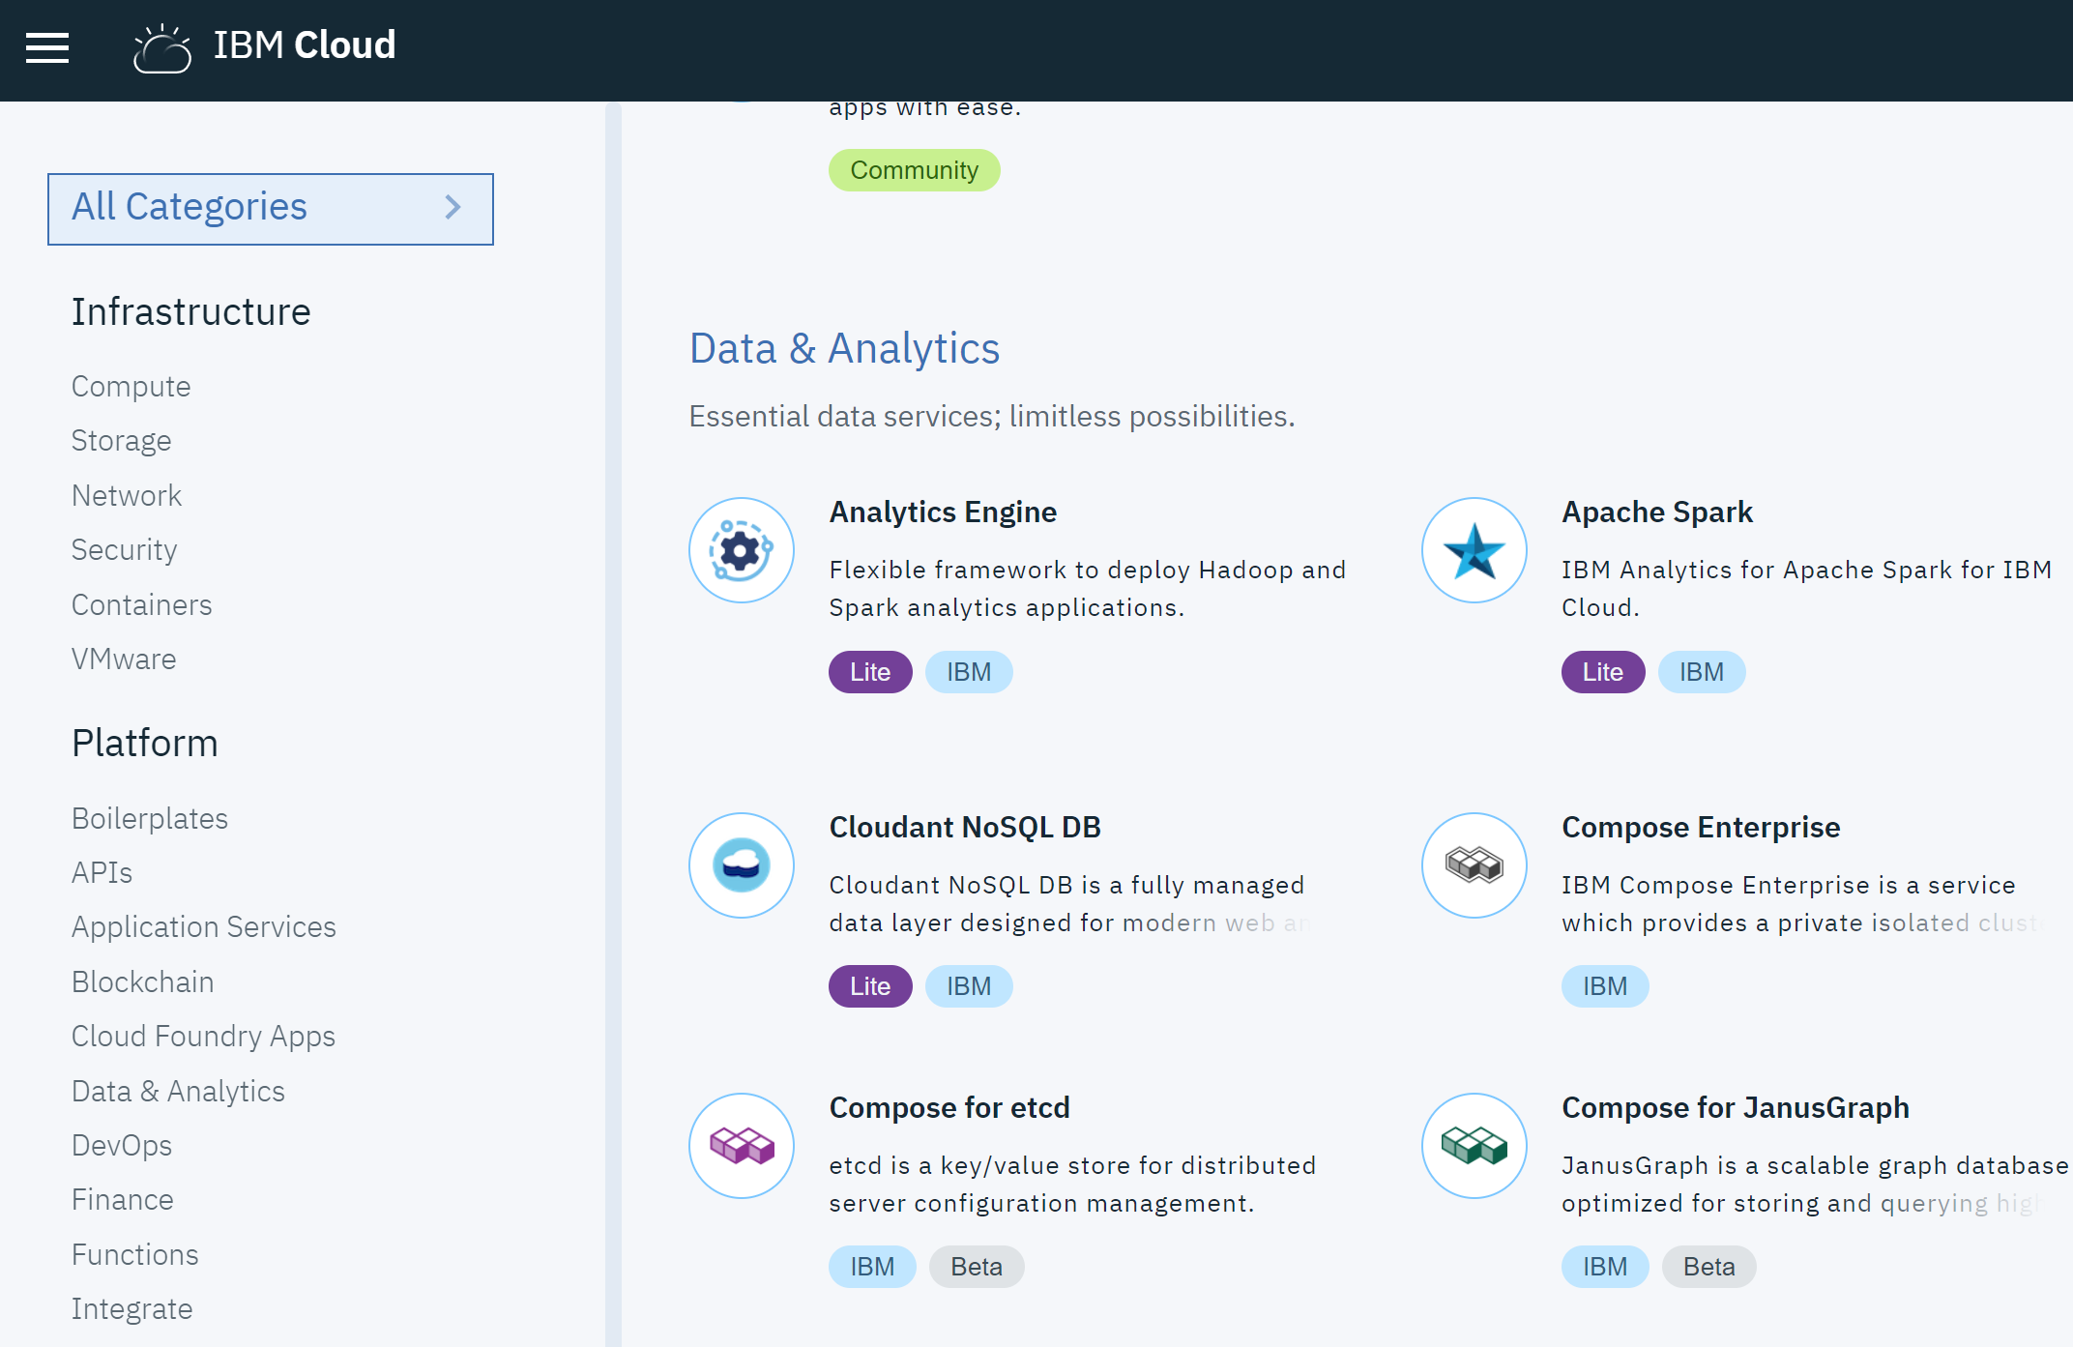
Selecting the template

Slide 7
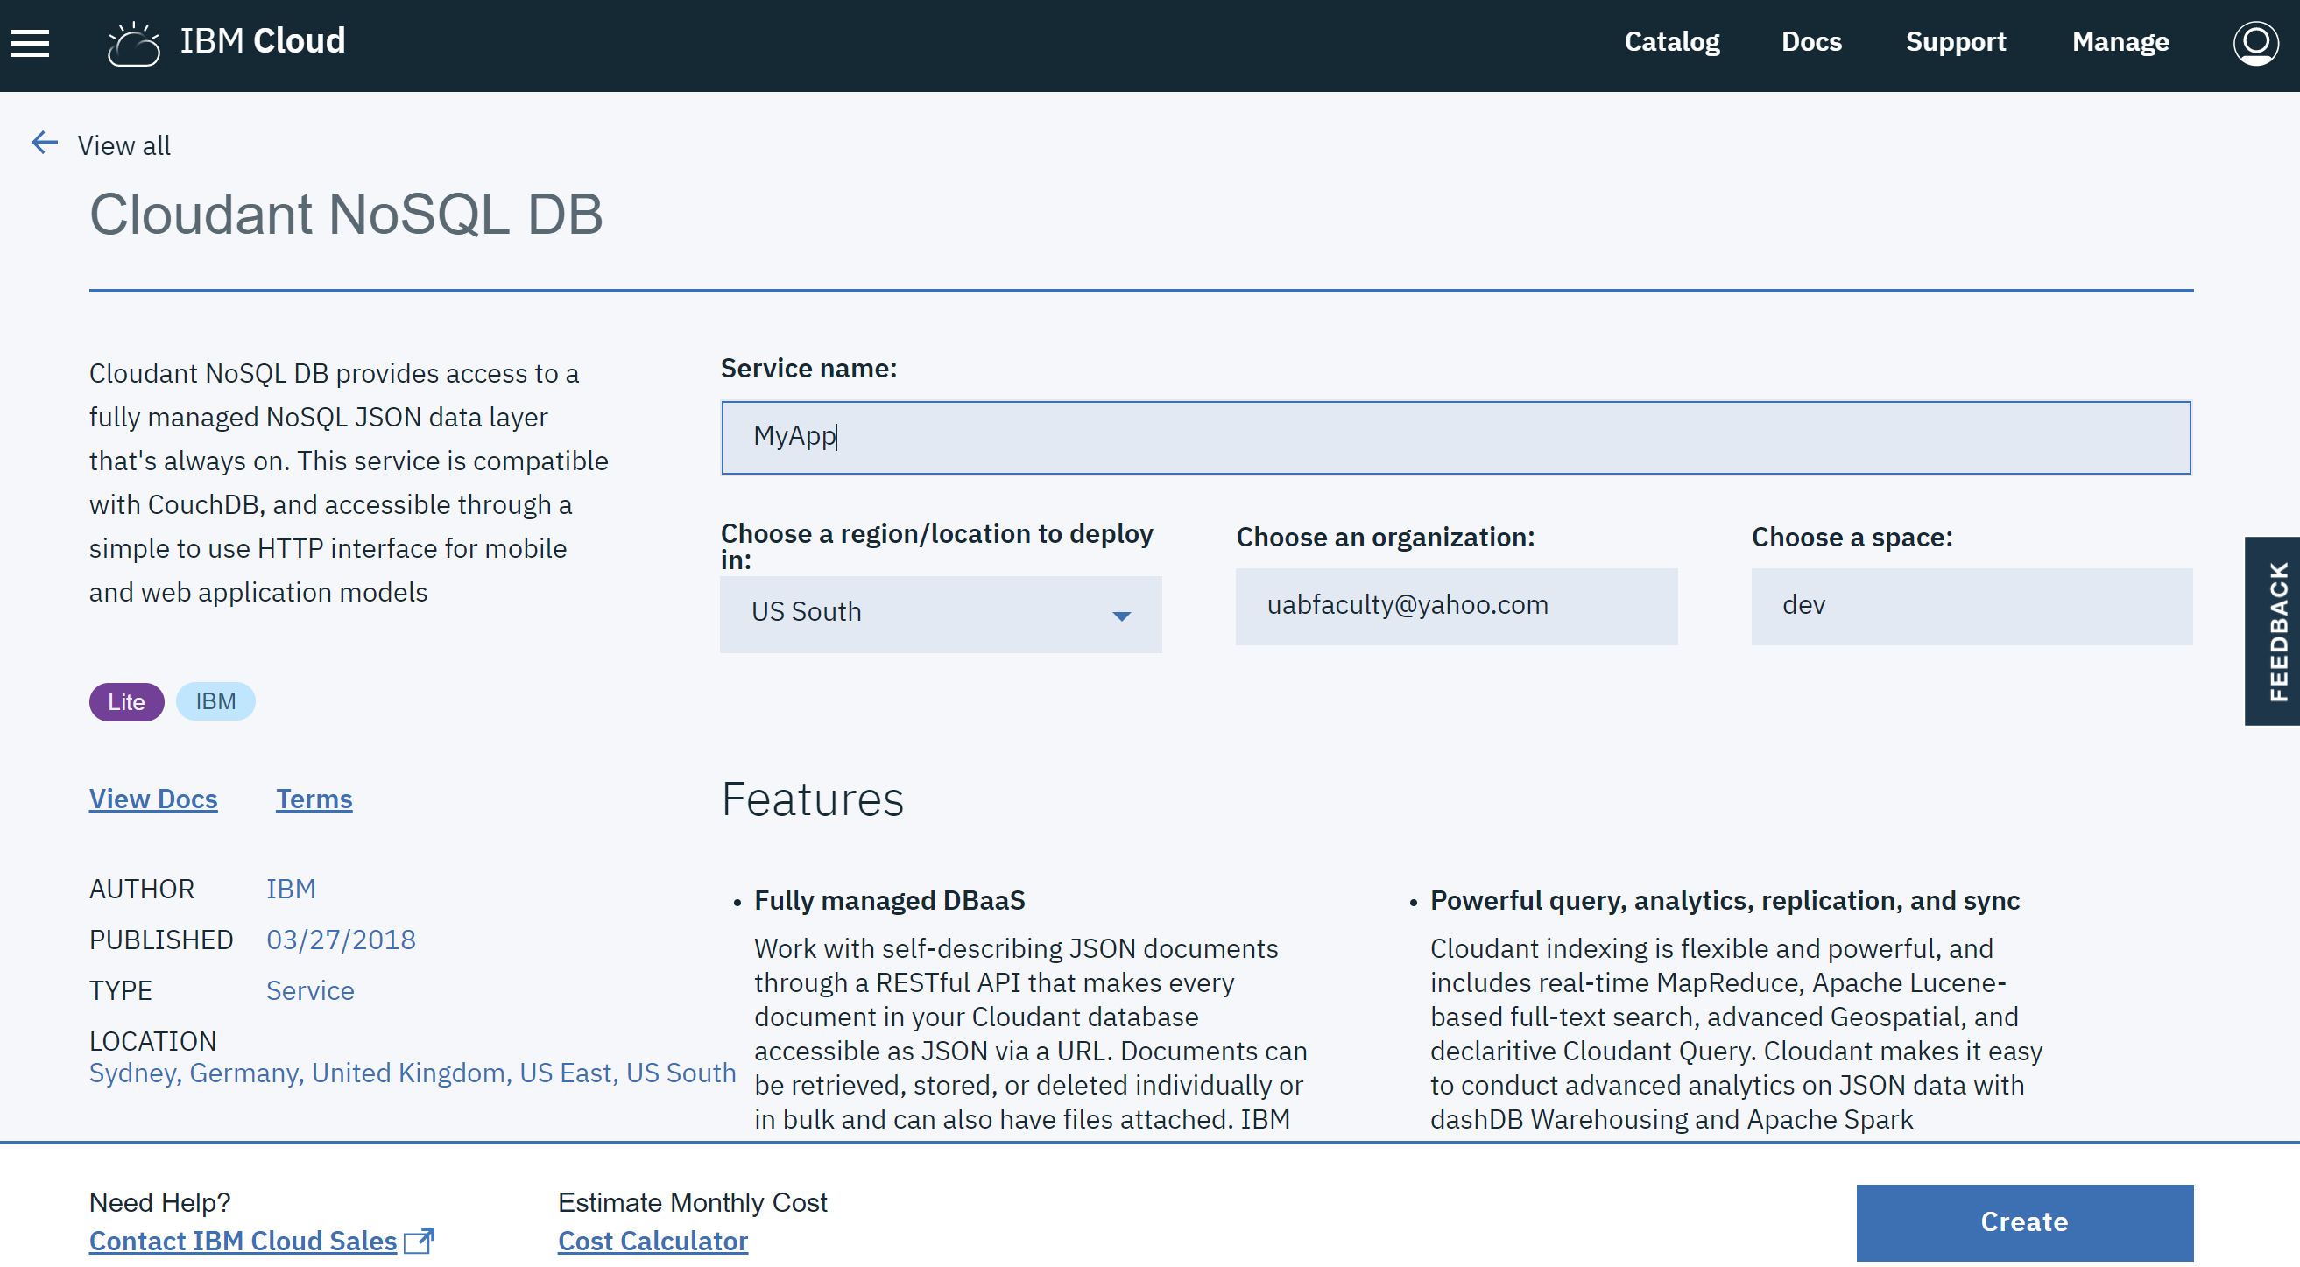
Creating the Database

Slide 8
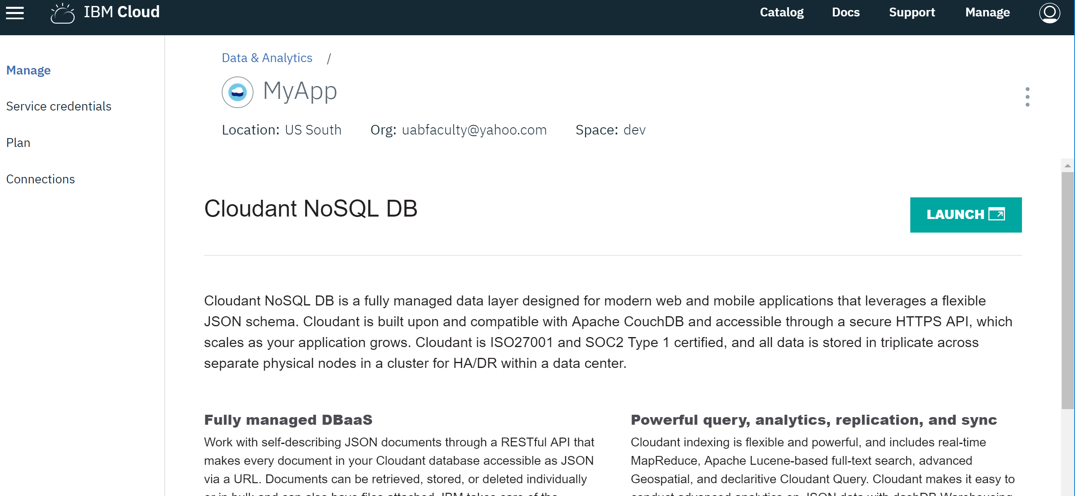
Launching the Database

Slide 9
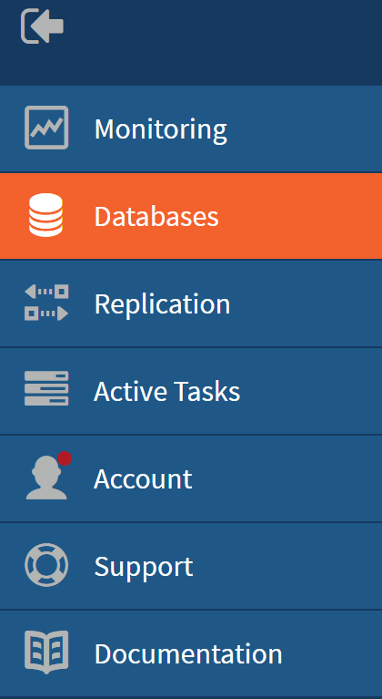
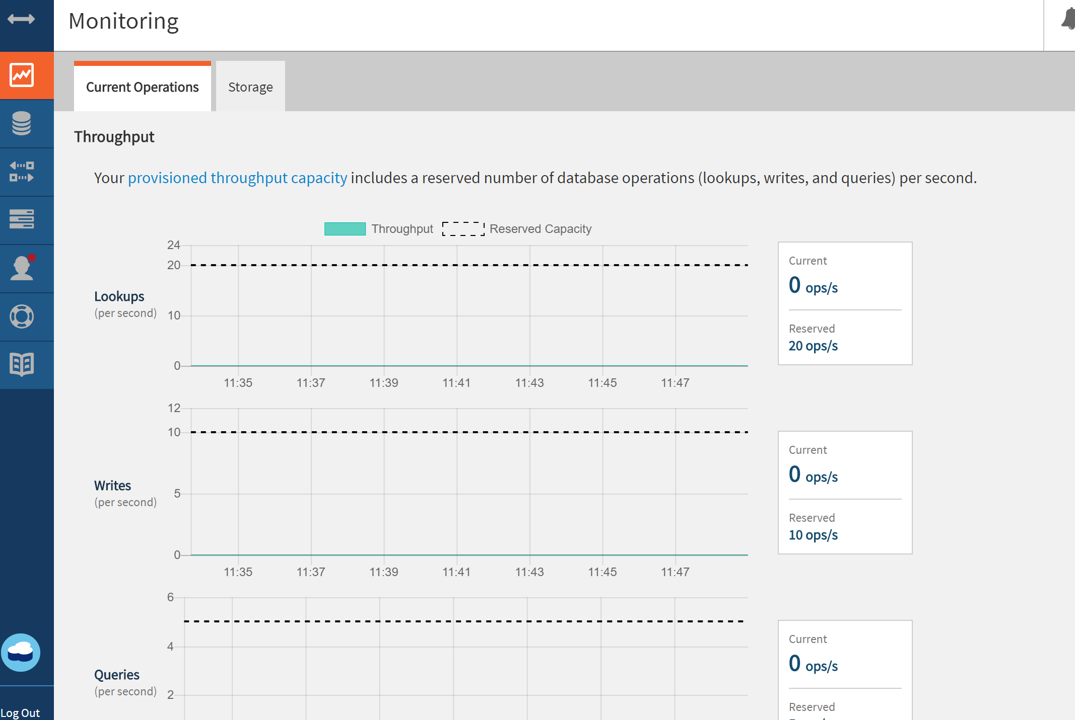
The Cloudant Interface

Slide 10
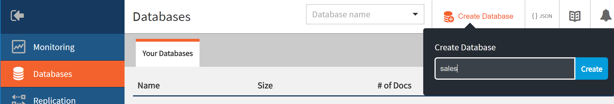


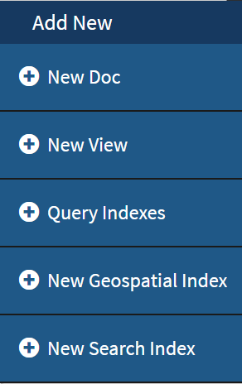
On the dashboard screen click on Create Database. Database names should contain only lowercase alphanumeric with no space.
To add a new document to your DB, click on the tab → →
Cloudant displays a JSON editor that verifies the correctness of the JSON contents being entered.

Slide 11
When you create a new document, Cloudant automatically assigns a unique document identifier (_id). Optionally, you can override the value of the document identifier.
The value of the _id key is used by the database to identify a document and must be unique in each database.
Each document in the DB can use the same schema or a unique schema.
The values can be: numbers, strings, Boolean, nested objects, arrays.
Click on the Save button to save the documents you have entered.
On the Dashboard screen, you will notice that Cloudant has added a new key/value pair to each document (_rev) in order to track document’s history.

Slide 12
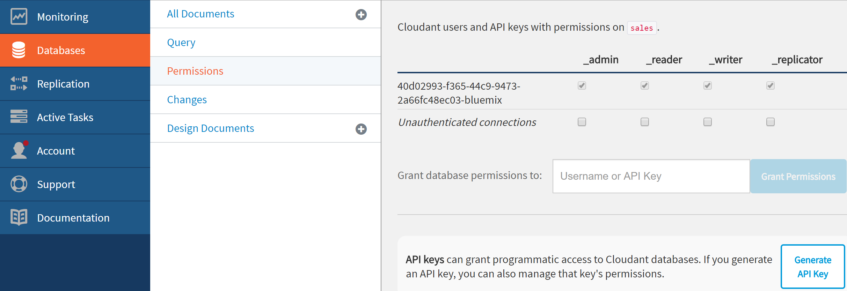
Cloudant allows you to set permissions on each individual database. Click on Databases → Permissions
You can give database access to individual users. They will be able to use the DB from their own dashboard.
To get programmatic access to a database, click on the Generate API Key to generate the needed credentials.
The Cloudant Web site includes some examples and tutorials to help you get started. You can replicate any of the sample databases to your account.

Slide 13
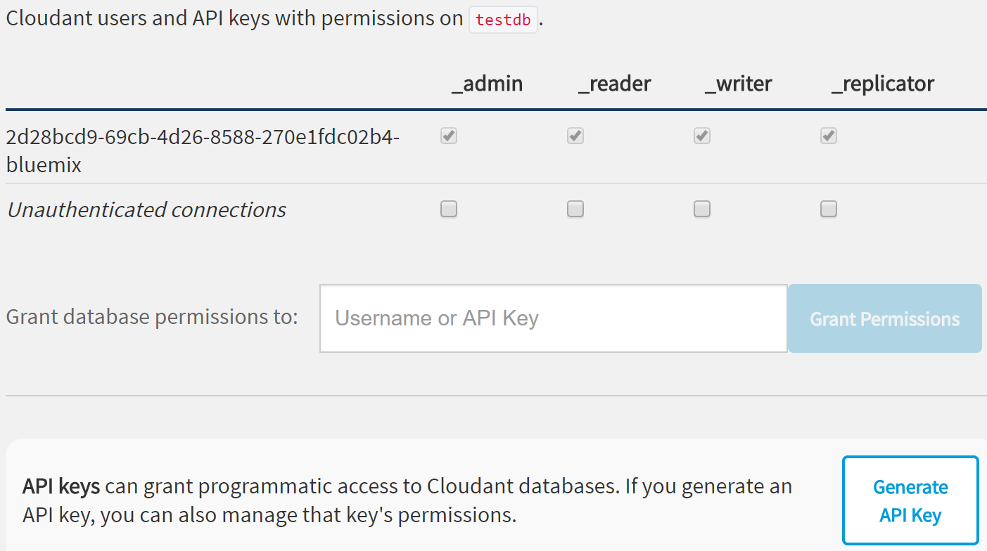
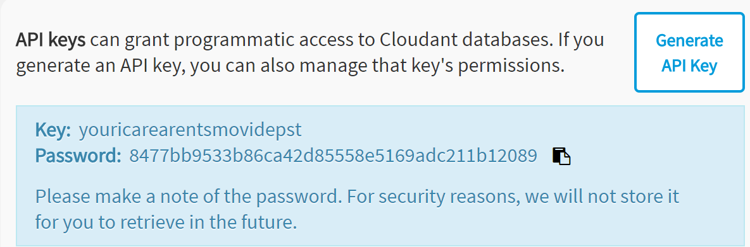
Generating the key/Password
Credentials for authentication
From within apps

Slide 14
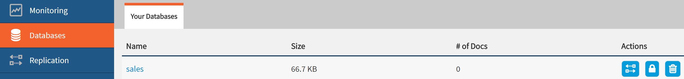
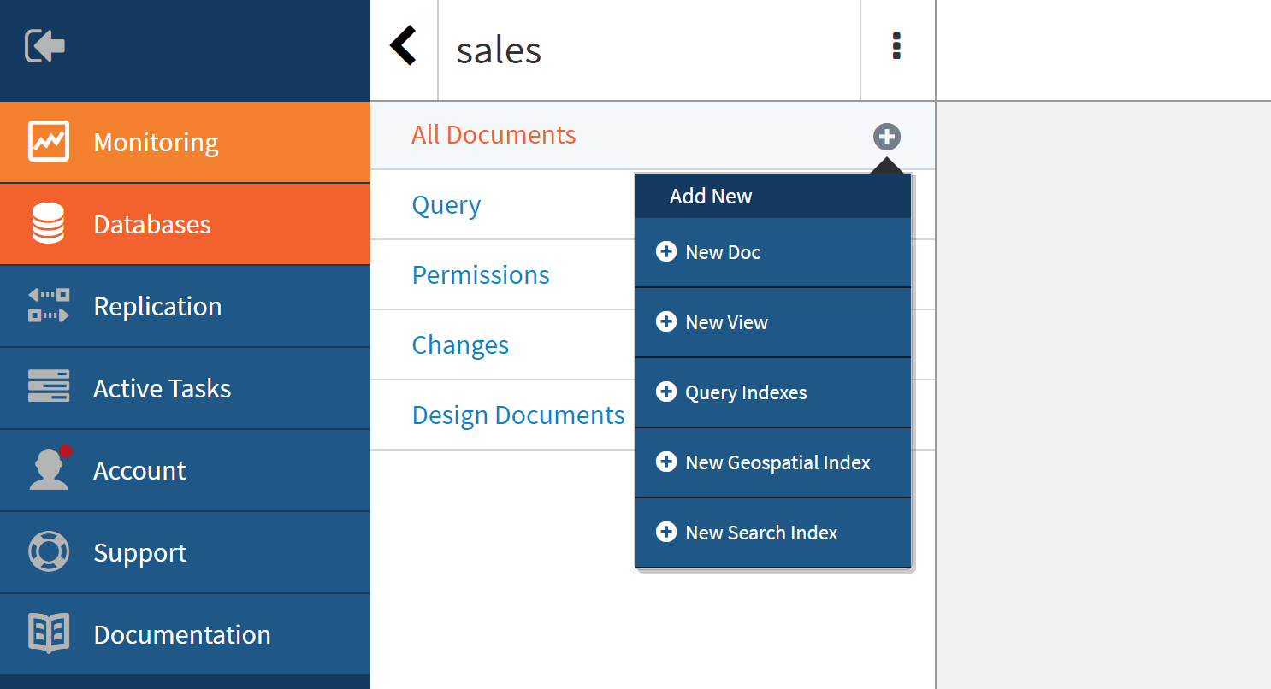
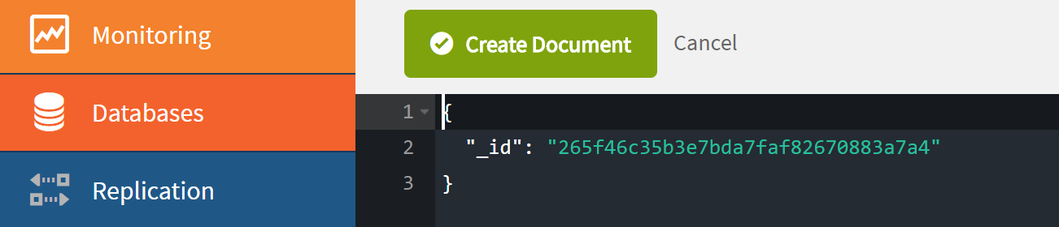
Creating Documents

Slide 15
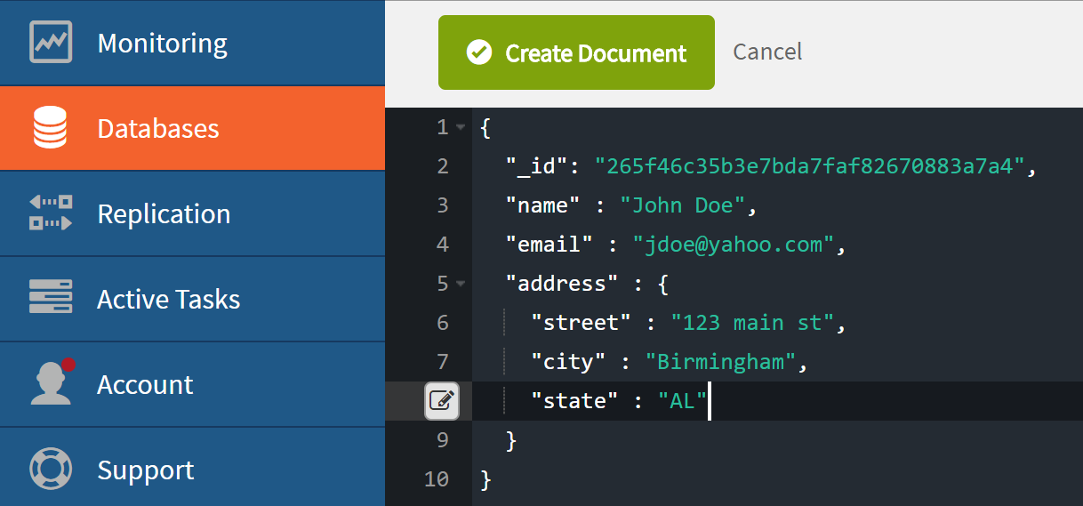
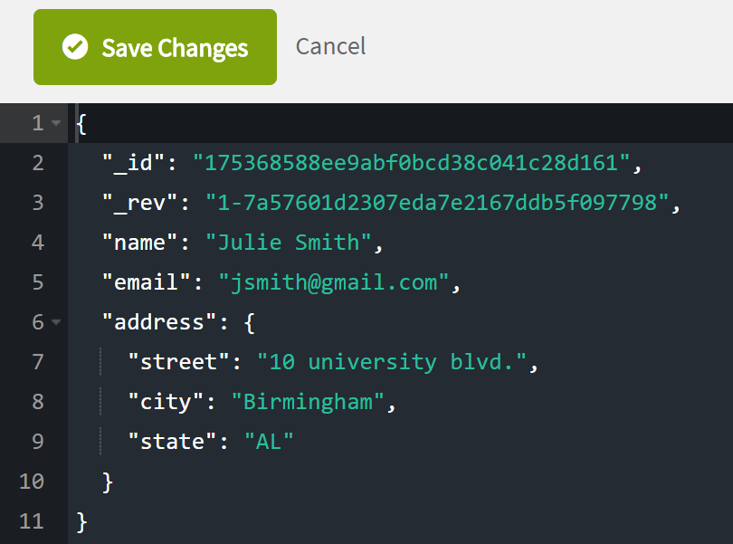

Slide 16
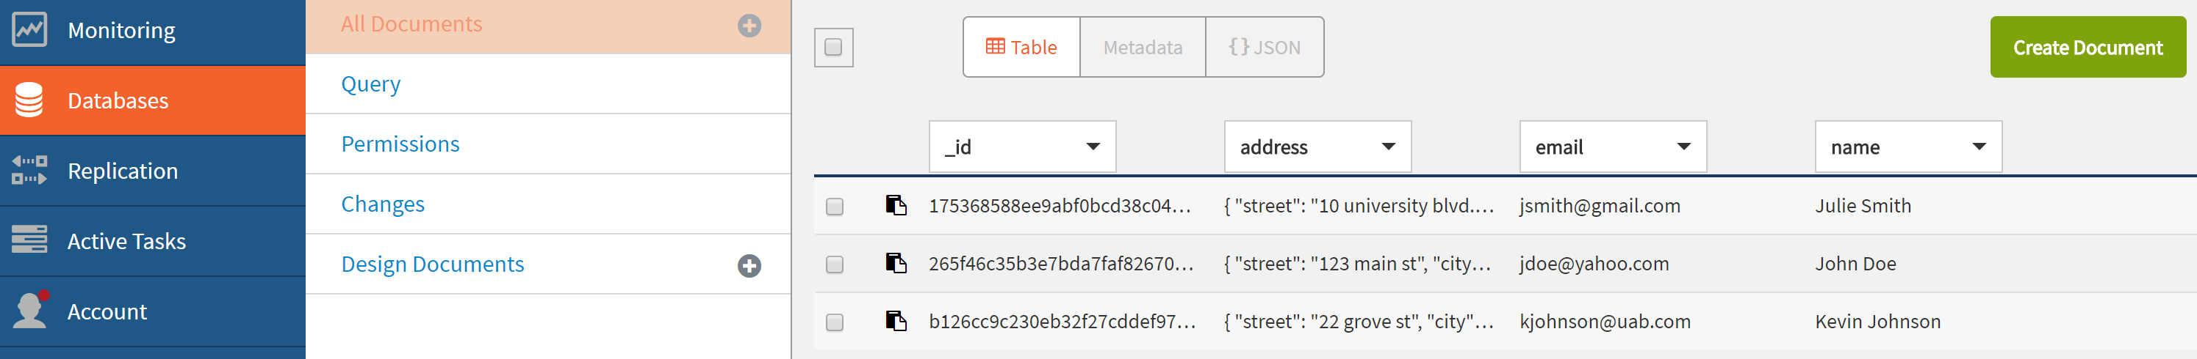
The Created Documents in the Database

Slide 17
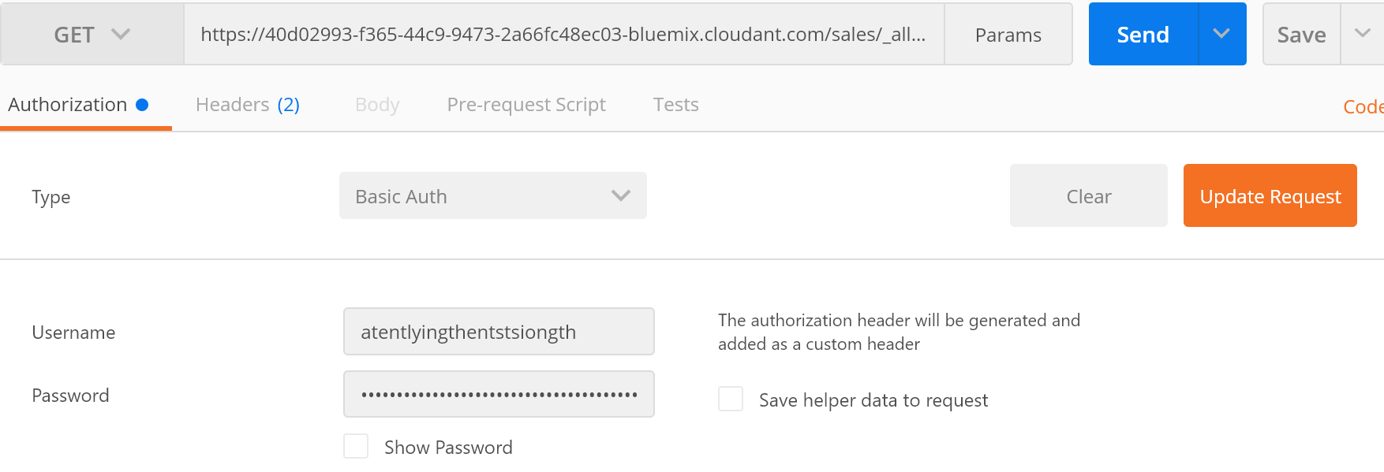
REST Access to Cloudant Database
The following command uses REST API to return all rows for the “sales” database: GET https://40d02993-f365-44c9-9473-2a66fc48ec03-bluemix.cloudant.com/sales/_all_docs
(Postman)
Key:atentlyingthentstsiongth
Password:e0882a2b2b58728103412802e3c82aef4100db17

Slide 18
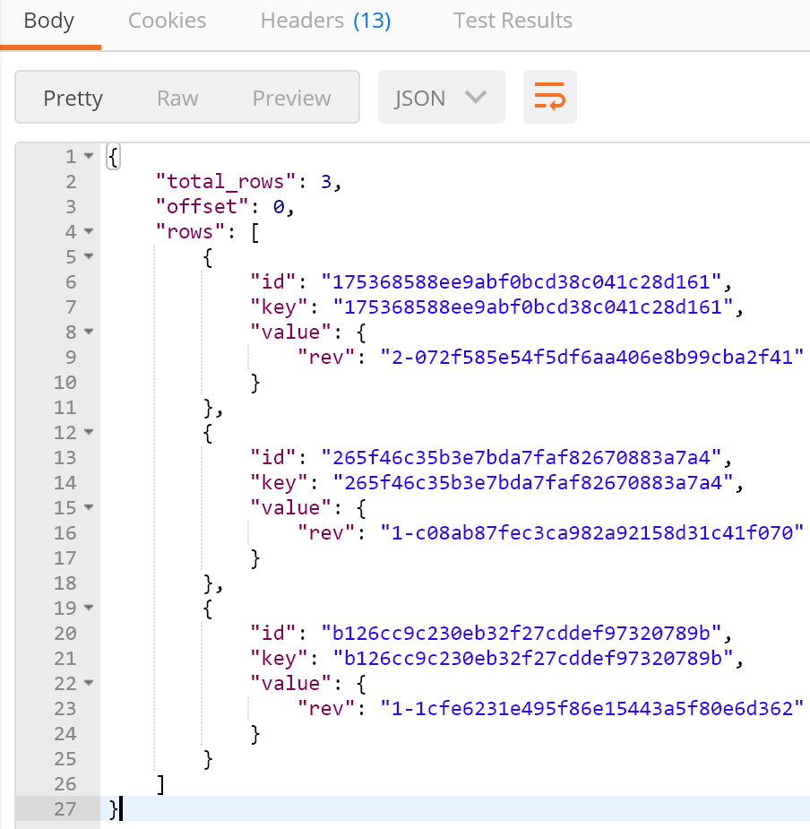
Returned results in Postman, Using:

Slide 19
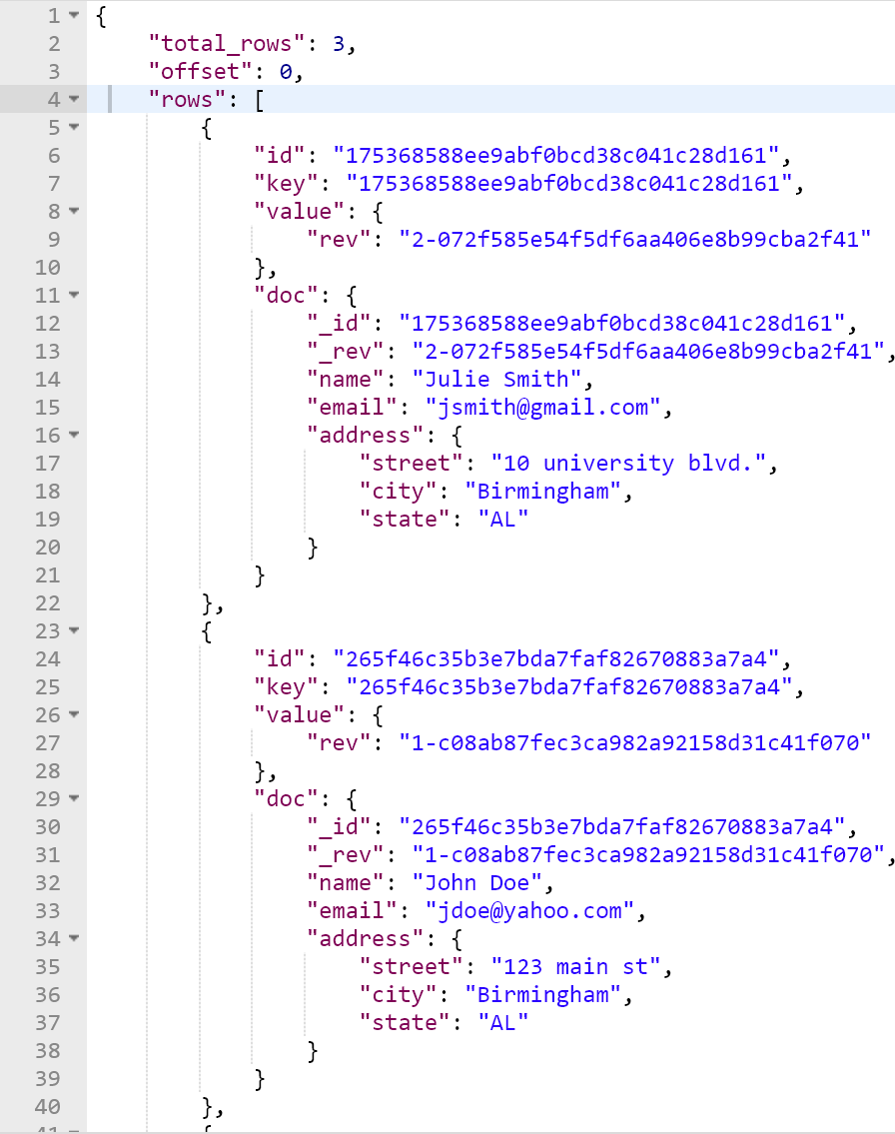
https://40d02993-f365-44c9-9473-2a66fc48ec03-bluemix.cloudant.com/sales/_all_docs?include_docs=true

Slide 20
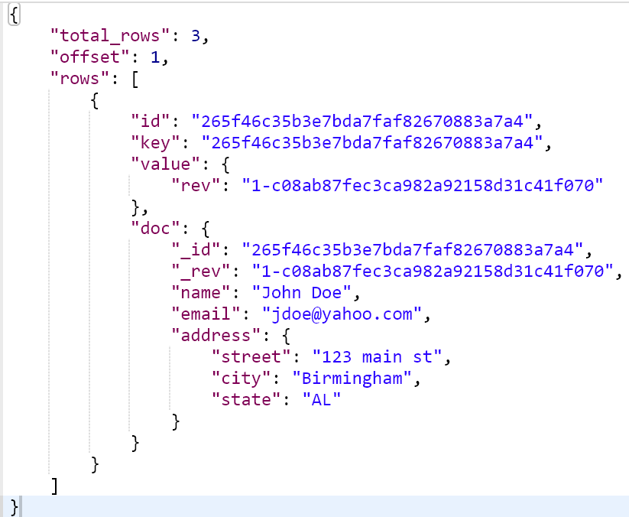
To retrieve the full document with ID 403f874115f9de40df0f27886e36fd68:
https://40d02993-f365-44c9-9473-2a66fc48ec03-bluemix.cloudant.com/sales/_all_docs?key="265f46c35b3e7bda7faf82670883a7a4"&include_docs=true

Slide 21
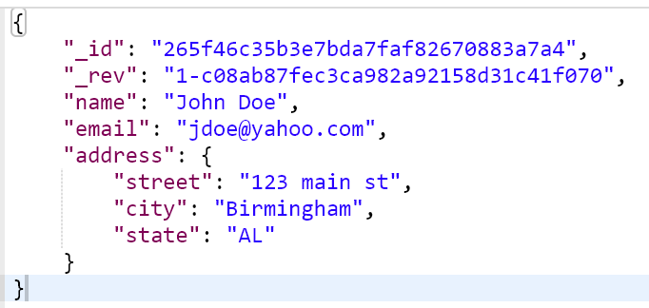
Alternatively, we can retrieve the same document using the unique _id as an argument:
https://40d02993-f365-44c9-9473-2a66fc48ec03-bluemix.cloudant.com/sales/265f46c35b3e7bda7faf82670883a7a4

Slide 22
The following table provides a list of the optional parameters that can be supplied to call to the _all_docs endpoint:
key Retrieve document with specific _id
startkey, endkey Retrieve range of documents based on primary key
include_docs=(true|false) Include document body into results, default "false"
descending=(true|false) Sort in descending order, default is “false”
limit=N Limit result to N documents
skip=N Skip over the first N documents

Slide 23
Examples
https://2d28bcd9-69cb-4d26-8588-270e1fdc02b4-bluemix.cloudant.com/sensordb/_all_docs?include_docs=true
https://2d28bcd9-69cb-4d26-8588-270e1fdc02b4-bluemix.cloudant.com/sensordb/_all_docs
?startkey="100"&endkey="235"&skip=2& limit=3
https://2d28bcd9-69cb-4d26-8588-270e1fdc02b4-bluemix.cloudant.com/sensordb/_all_docs?limit=4

Slide 24
Defining Secondary Index or Map Function
Secondary indexes, or views, are defined in a map function, which pulls out data from documents and with an optional reduce function that aggregates the data emitted by the map.
The map functions are written in JavaScript and held in "design documents".
They can be thought of as documents that define secondary indexes.

Slide 25
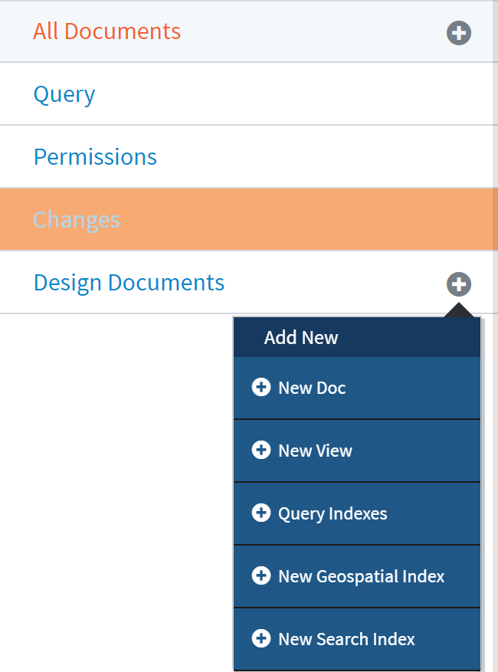
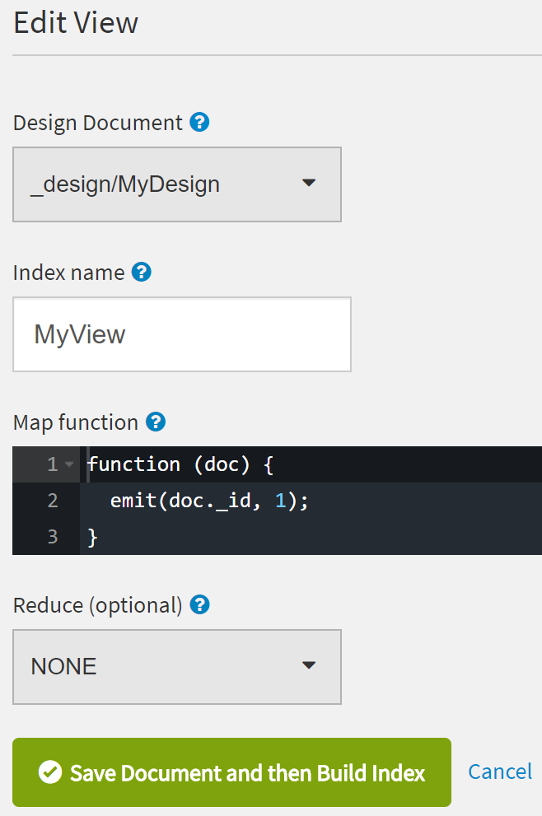
To define a secondary index: In the database view,
select “+” next to “All Design Docs” line → “New View”

Slide 26
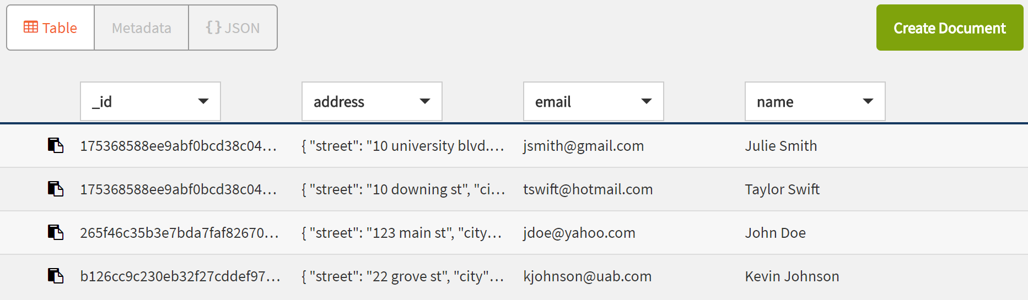
Results from Executing the View in Cloudant

Slide 27
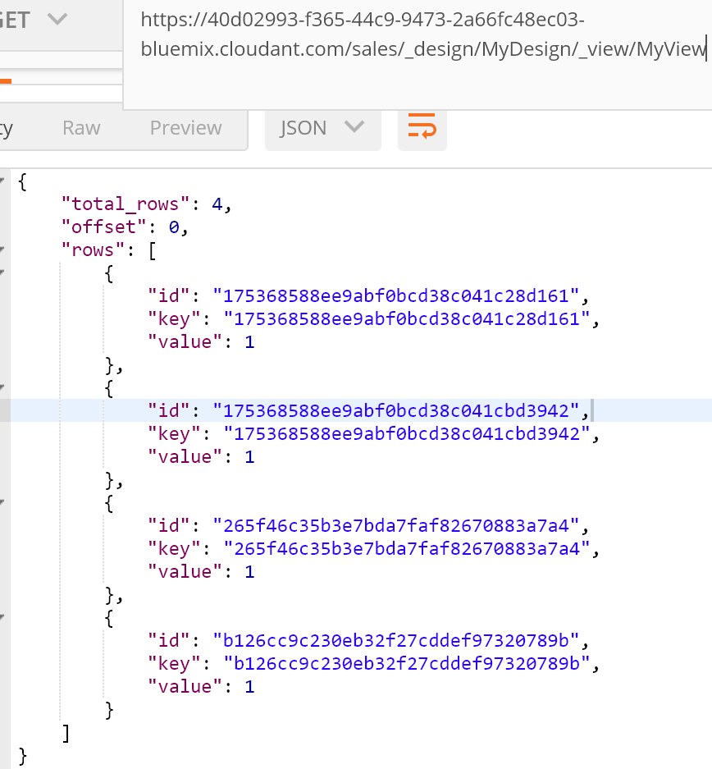
Results using Postman
https://40d02993-f365-44c9-9473-2a66fc48ec03-bluemix.cloudant.com/sales/_design/MyDesign/_view/MyView

Slide 28
Using Postman to Inspect a View or Secondary Index
To find the data using the high_temp index in the Temperature design documents :
GET https://.../sensordb/_design/Temperature/_view/high_temp
To see all fields in documents, we can use the include_docs option equal to TRUE. We can also limit the result to 2 documents:
GET https://.../sensordb/_design/Temperature/_view/high_temp
? include_docs=true&limit=2

Slide 29
To find sensor data with temperatures between 23 and 24, but only return up to 1 row, skipping the first row, you can submit the following request:
https://2d28bcd9-69cb-4d26-8588-270e1fdc02b4-bluemix.cloudant.com/sensordb/_design/Temperature/_view/high_temp?startkey=23&endkey=24&skip=1&limit=1

Slide 30
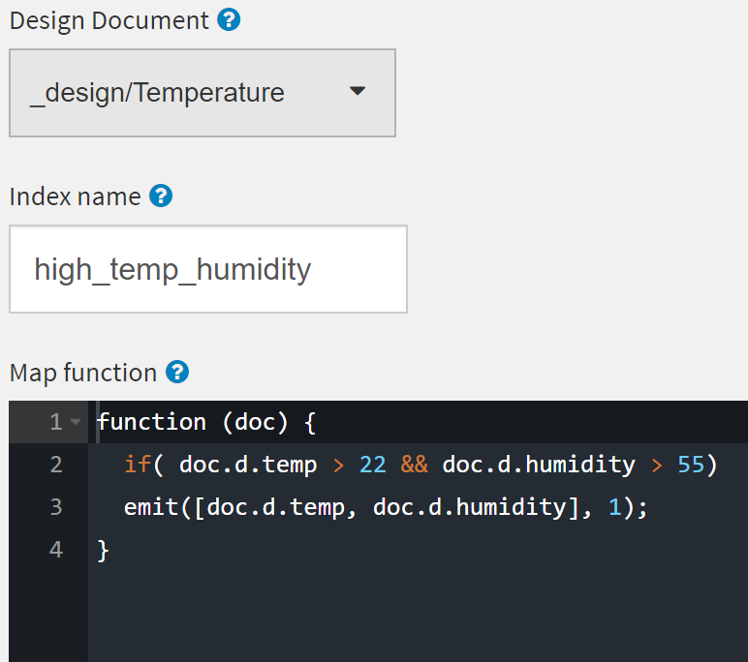
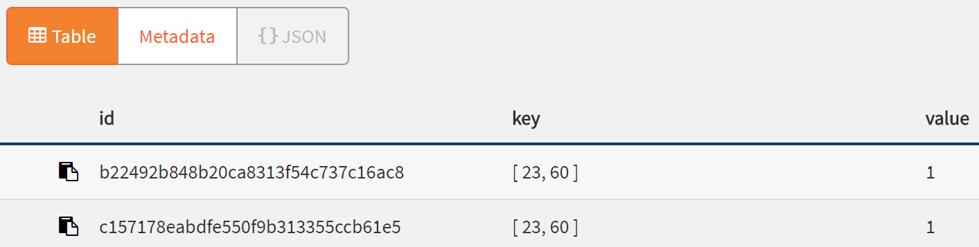
Complex keys

Slide 31
The Reduce Function
The Reduce function processes the output of the map operation to aggregate results.
Reduces are called with three parameters: keys, values, and rereduce.
- keys will be a list of keys as emitted by the map or, if rereduce is true, null.
- values will be a list of values for each element in keys, or if rereduce is true, a list of results from previous reduce functions.
- rereduce will be true or false.
Whenever possible use of the built-in reduce functions.

Slide 32
Built-in Reduces
_count Reports the number of docs emitted by the map function, regardless of the emitted values’ types.
_sum Given an array of numeric values, _sum, sums them up. This can be used to report a summary of salaries for each department.
_stats Produces a JSON structure containing the sum, count, min, max, and sum squared.
As in the case of _sum, the _stats function only works with numeric values and arrays of numbers; an error is generated if a string or an object is passed as the argument for the function.

Slide 33
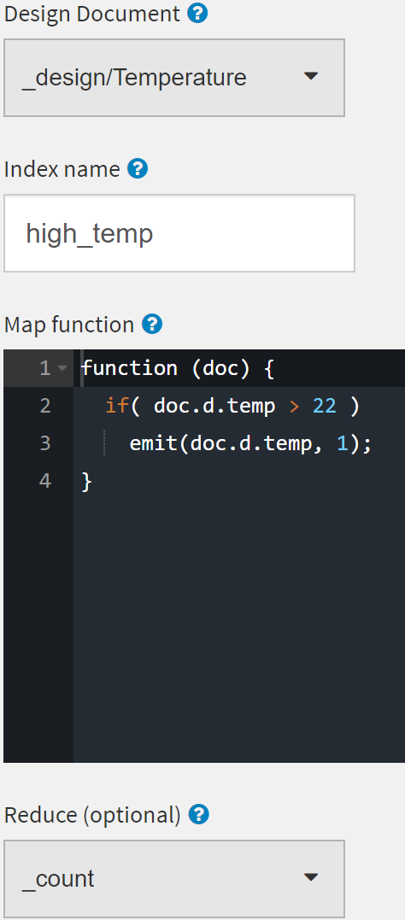
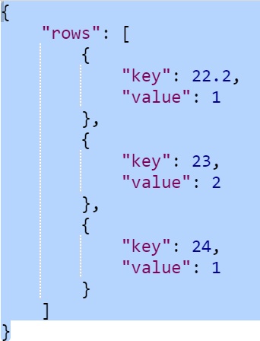
To create an index that counts:
To create the query to the index:
GET https:// … /sensordb/
_design/Temperature/_view/high_temp
?group=true

Slide 34
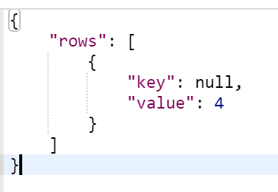
Using the same request but without group=true option, the database server returns the number of documents in the database:
GET https:// … /sensordb/_design/Temperature/_view/high_temp

